Slide 1
PRSENTATION Foody – FOOD DELIVERY APP
ENGINEERING COLLEGE, AJMER
(2021-22)
SUPERVISOR
Dr. Prakriti Trivedi
Associate Professor
Dept. of CSE
Presented By:-
Aatmik Ranjan Mishra(18CS01)
Ashutosh Rangroo(18CS13)
Aditya Rangroo(18CS03)
Chinmay Rajpurohit(18CS17)

Slide 2
Project Vision
Foody is a platform that will deliver home-cooked food directly from your home kitchen as our motto is to provide food that our customers can eat 365 days without making any adjustments on their health and wallet. We are also delivering food directly from your kitchen to your work location. So, every meal at your work is always fresh and healthy. No matter how busy someone is they shouldn't skip their meal so we bring an app to overcome all your problems.
"Missing homemade food far from home - download Foody Food Delivery app and get fresh food directly from Mom's kitchen.“
"Why bread-earner of the family eats stale food every day-download Foody Food Delivery app, and we will deliver your kitchen meal to your work."

Slide 3
Application Structure
There will be three various applications with distinct functionality and features,
Customer App: This app will be designed for the customer, and it will be user friendly. This app will be used by users and help them place a food order, track order, and compare different food partners and offers.
Food Partner App/Admin Panel: A feed partner controls and manages the delivery orders with this web-based platform and mobile app.
Delivery Driver app: The delivery personnel manage pick-up and drop-off of orders with this app.

Slide 4
Features of Application
User Friendly Ul(On all the sides including Customer, Driver and Kitchen)
Can search and compare different food partners, location, price, ratings, review
Can save their favorite dishes, food partner and eateries so that they don't have to search all over again
Advance meal menu at least before the week
Accurate locations (Location of the kitchen for drivers as well as for customer pick-ups)
Notify customer and driver when the food is ready to be picked up Orders can be placed according to the customers' choice (Scheduled Order)
Easy, fast and secured payment option and also the option of COD.

Slide 5
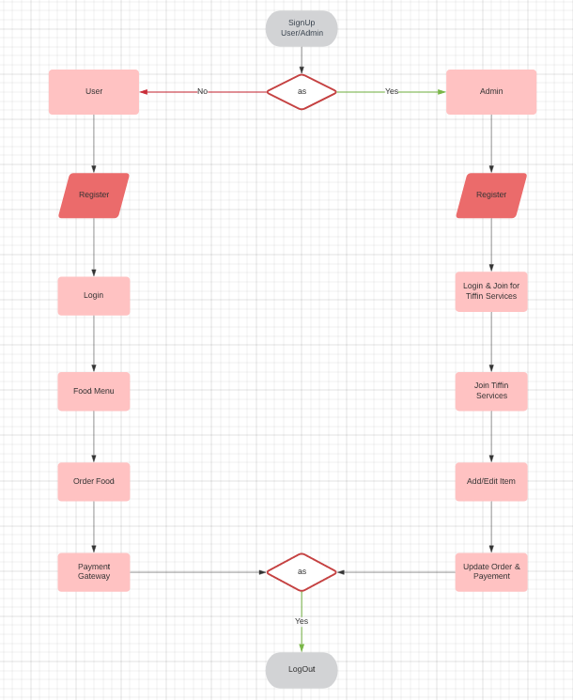
Application Flow Chart

Slide 6
Novelization
Most of these food delivery system offers restaurants or local food joint's food and we are here to provide the customers fresh home cooked meal.
Our other main feature is that we also provide the delivery service from the users home to their work location.
There are few people providing the Tiffin services but they do not have any platform to market their services so for them this app will be an ideal place to provide their home food delivery service.
Easy to bring and connect customers to these small food vendors.
More secure than other food apps.
No money required from local food vendors like other big food delivery apps.
Also accept crypto based payment.

Slide 7
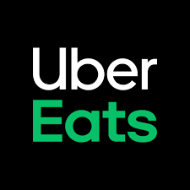
Competitive Analysis
Uber Eats - Food Delivery App
Uber Eats is an American online food ordering and
delivering platform launched by Uber in August 2014.
From the app browse local restaurants and fast food
favorites for inspiration, or get just what you are looking
for by searching for a specific restaurant, dish, or cuisine.

Slide 8
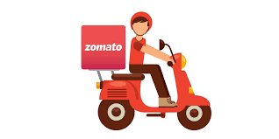
Competitive Analysis
ZOMATO - Food Delivery App
Zomato is an Indian multinational restaurant
aggregator and food delivery company founded
by Deepender Goyal and Pankaj Chadha in 2008.
Zomato provides information, menus and user-reviews
of restaurants as well as food delivery options from
partner restaurants in select cities.

Slide 9
Technology Stack
Android Studio
Java
XML
Firebase
GitHub
Java Runtime Environment
Android Physical Device
PC(Minimum 4GB RAM and latest processor)

Slide 10
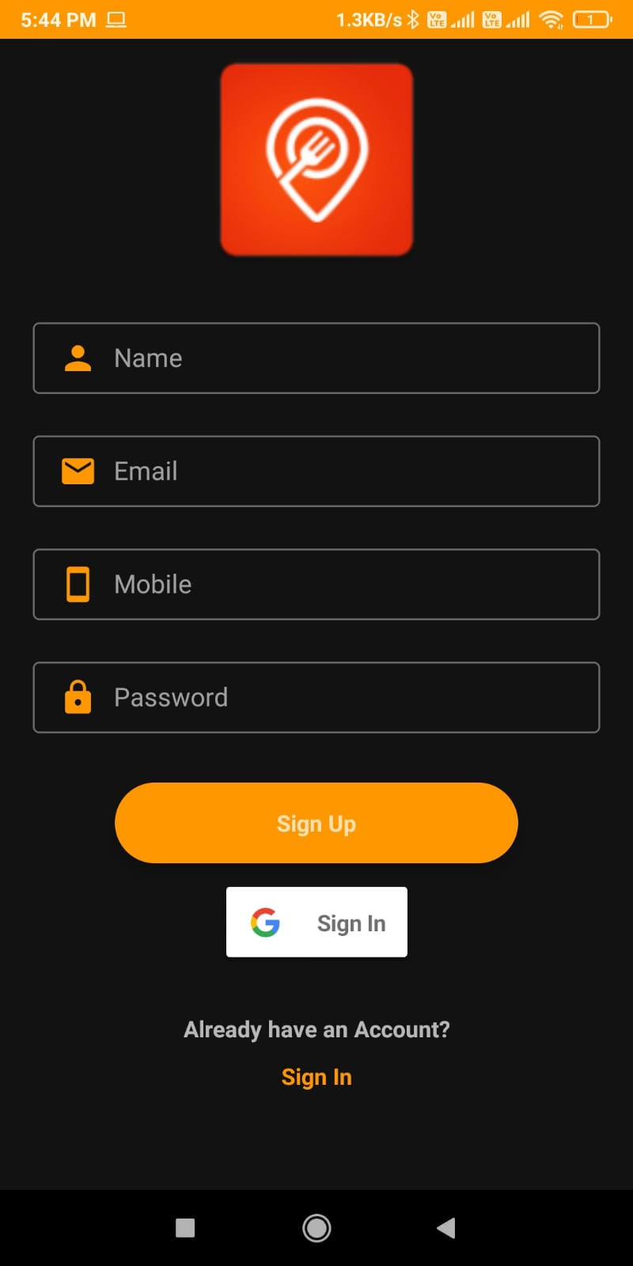
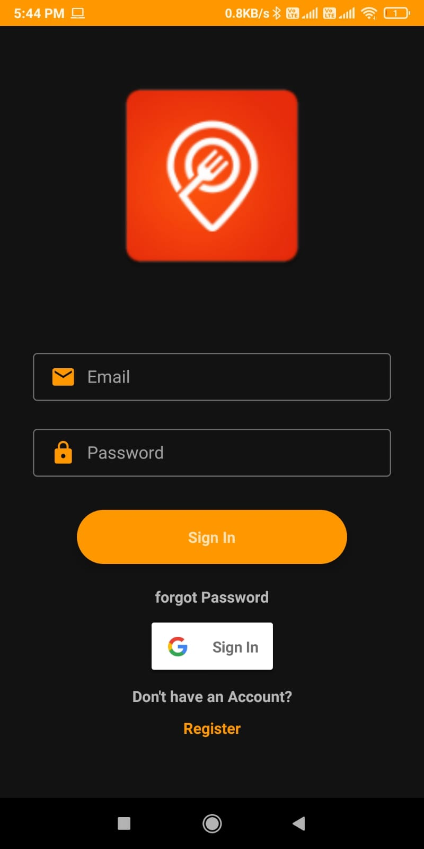
Application Snapshots
Login and Registration :

Slide 11
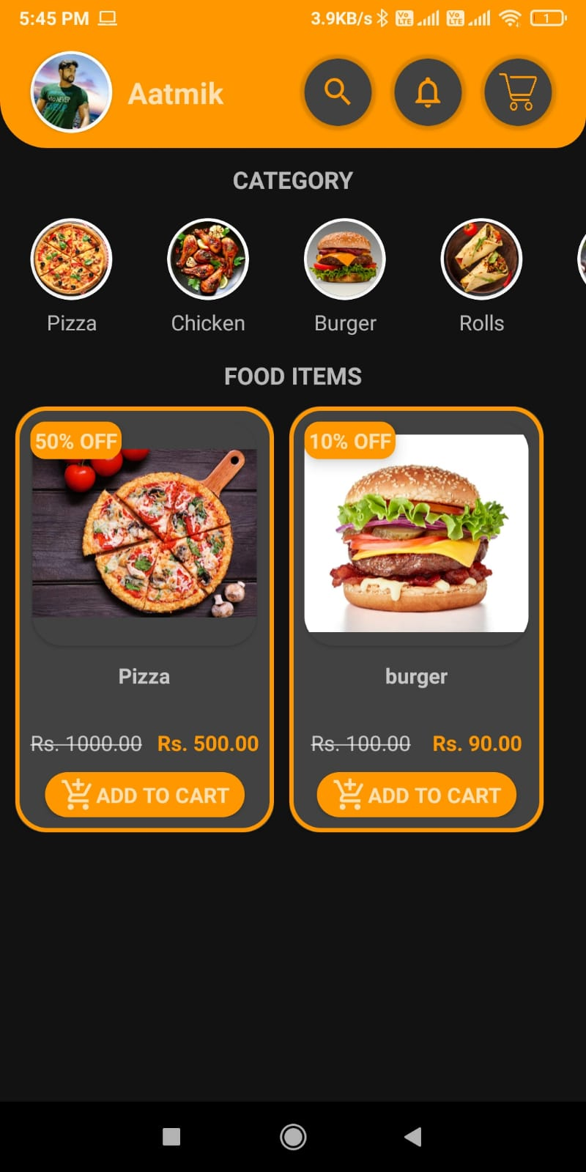
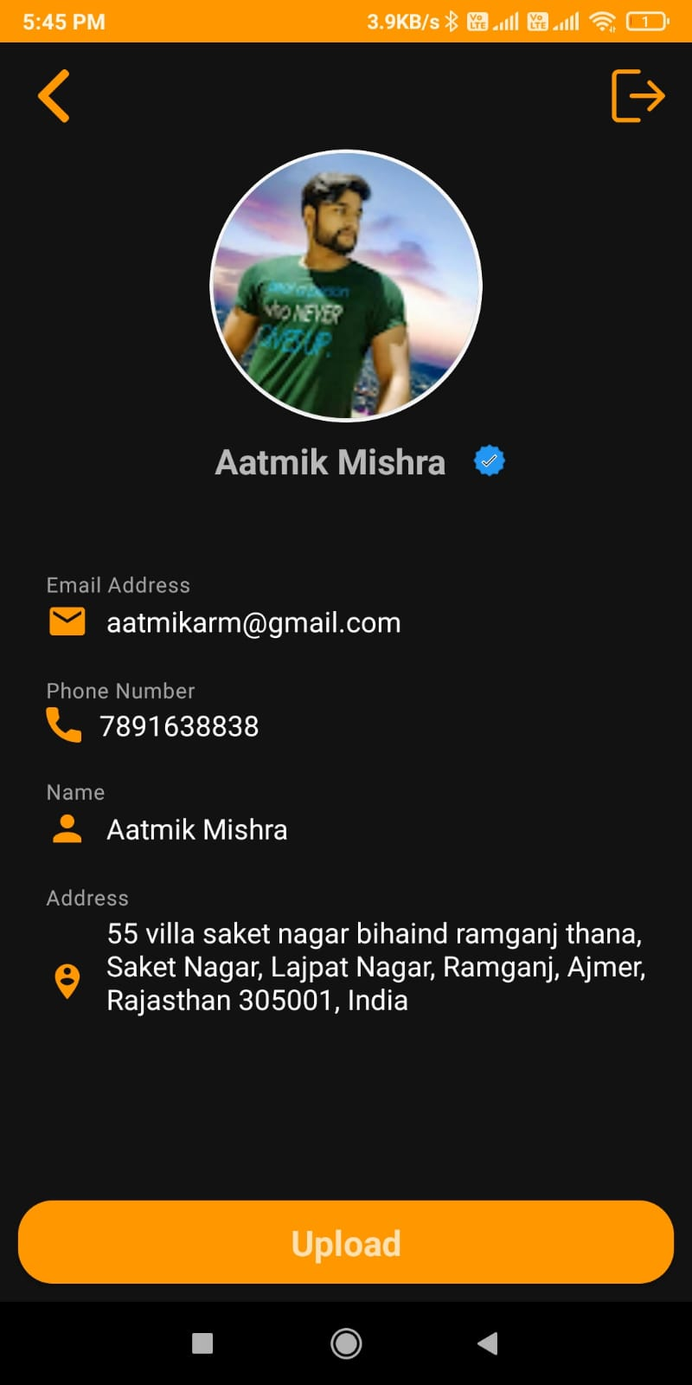
Application Snapshots
Main Screen and Profile :

Slide 12
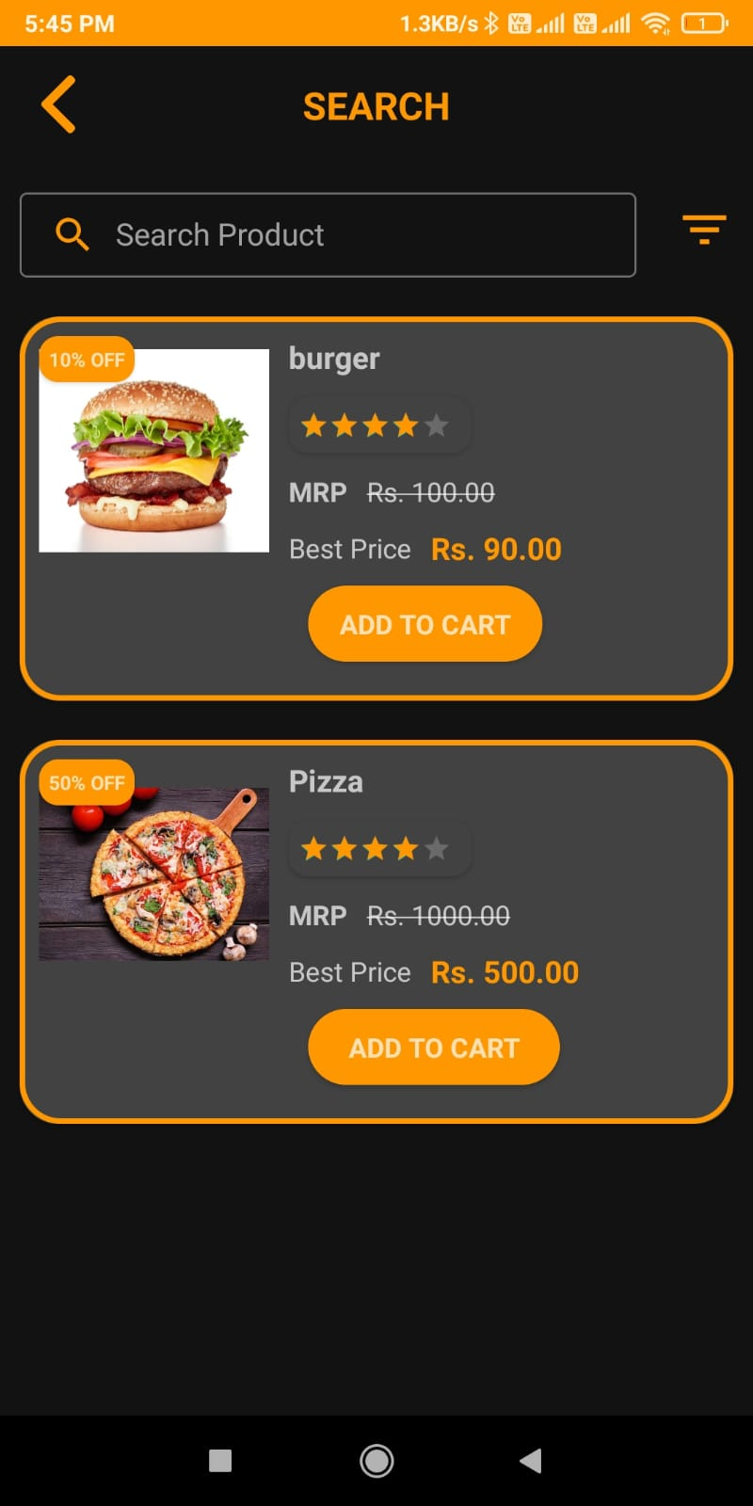
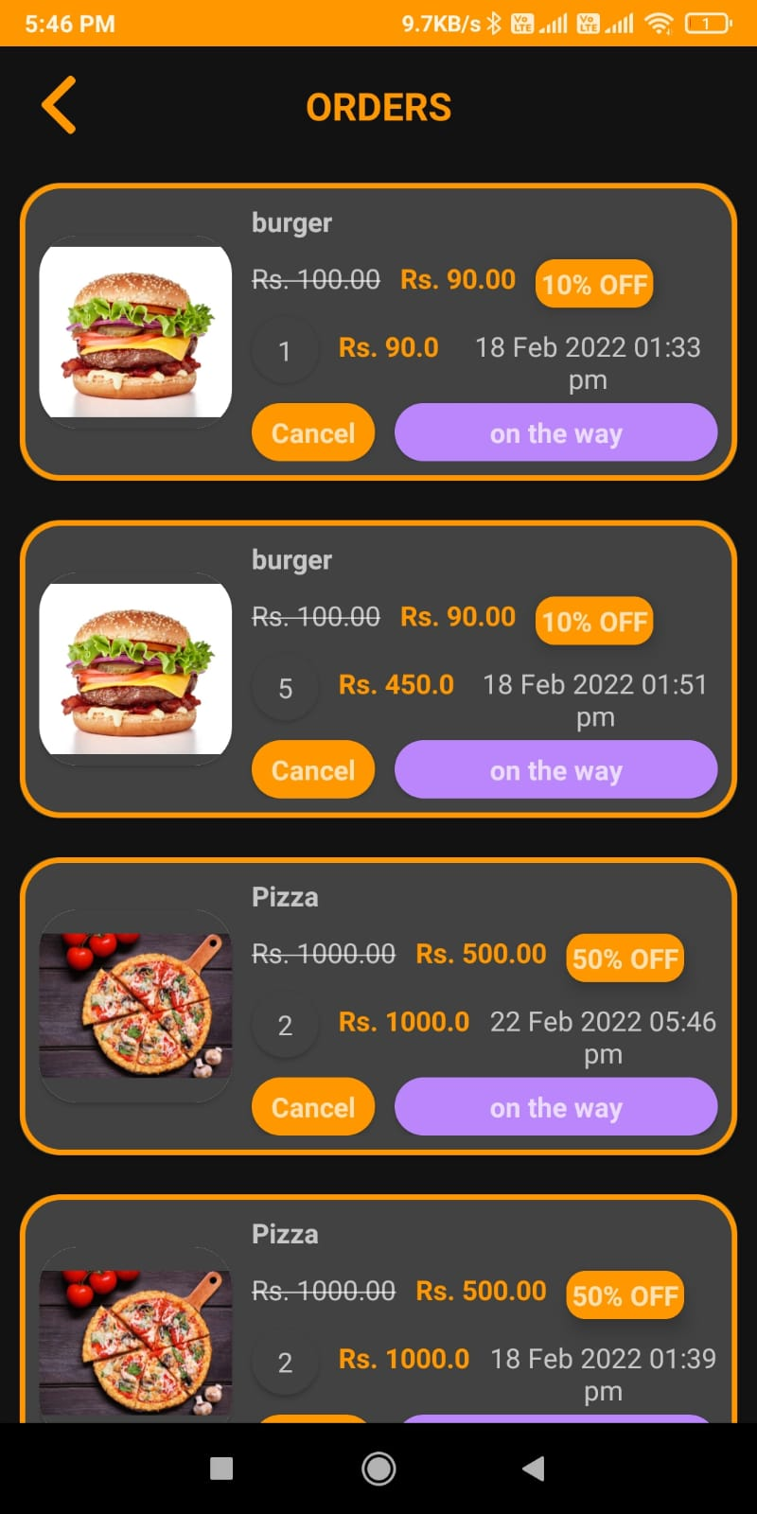
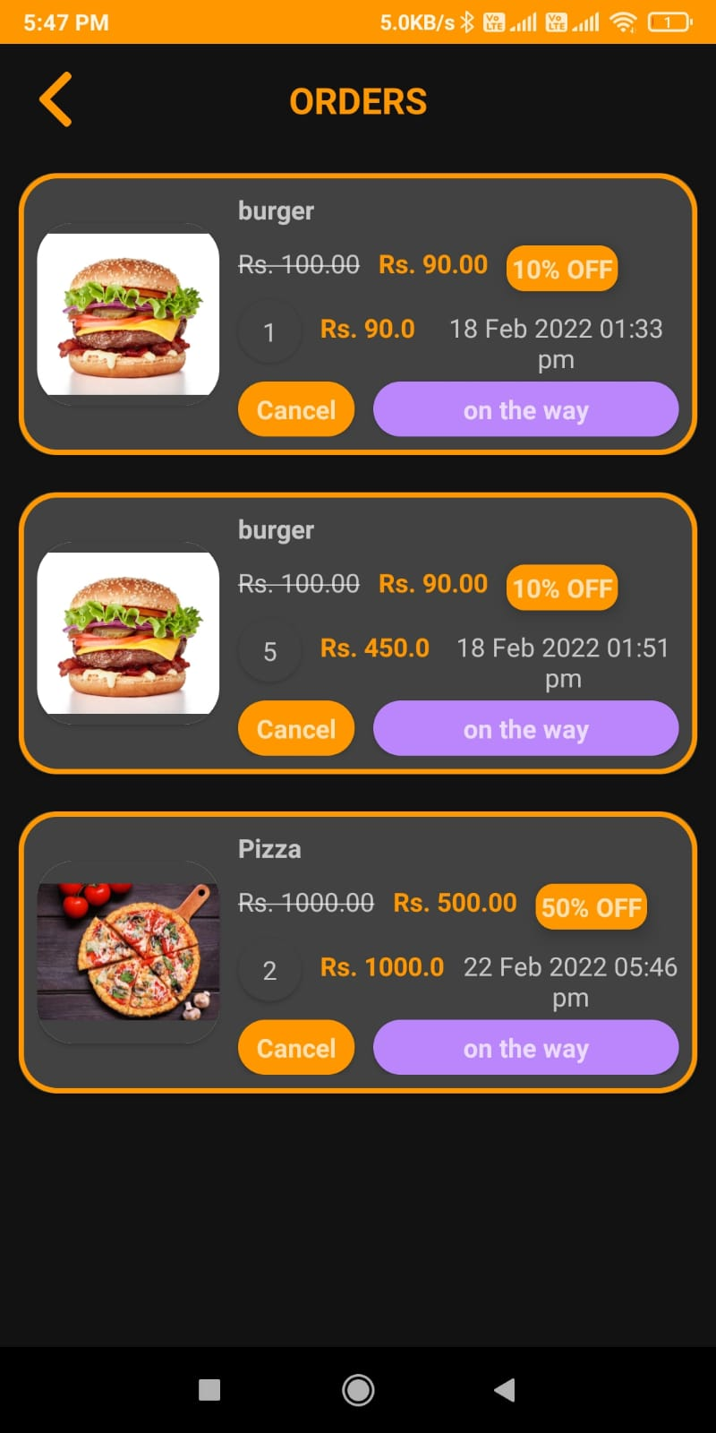
Application Snapshots
Search and Order your Food :

Slide 13
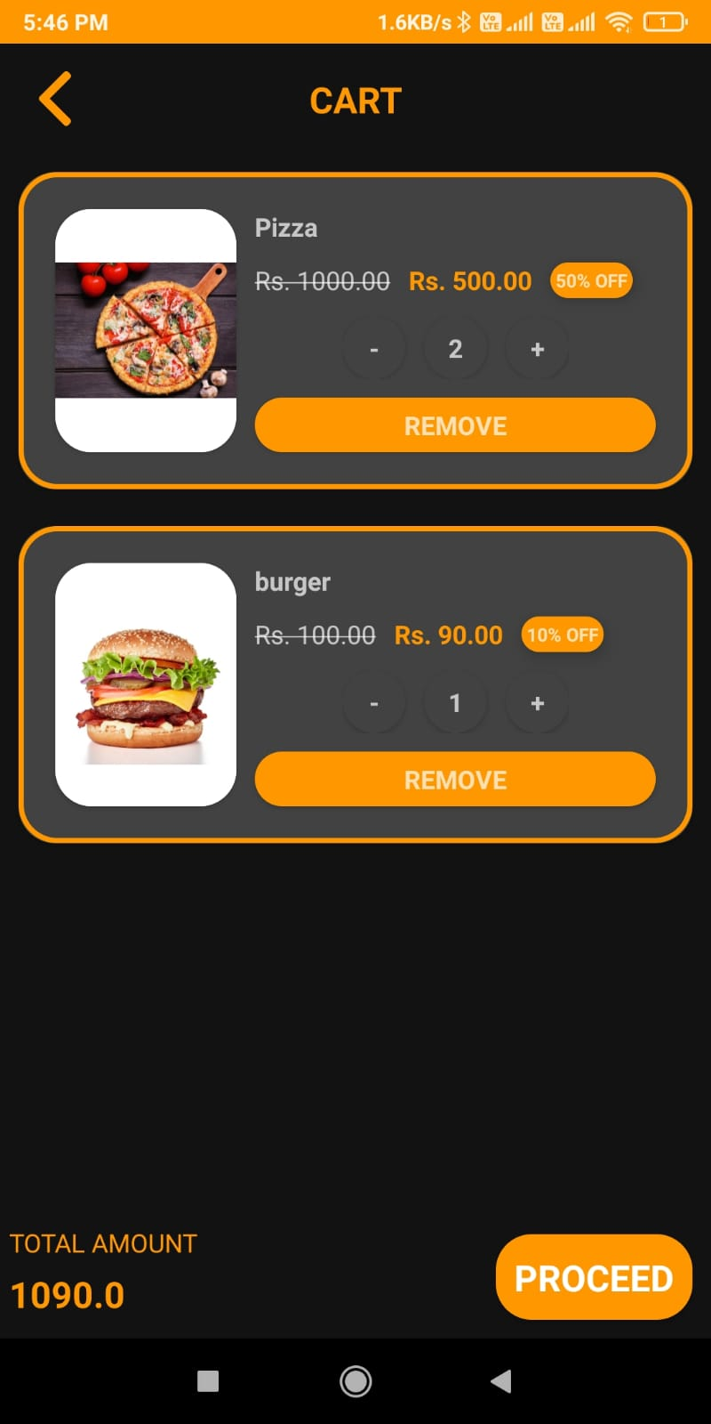
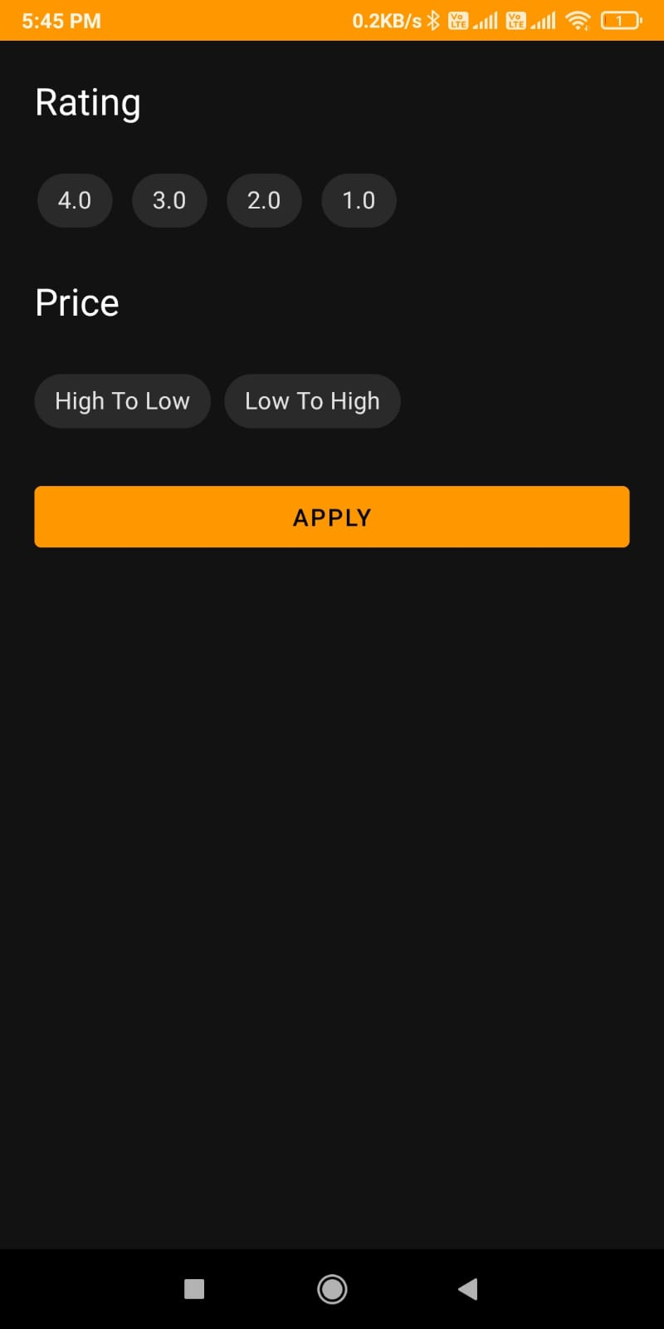
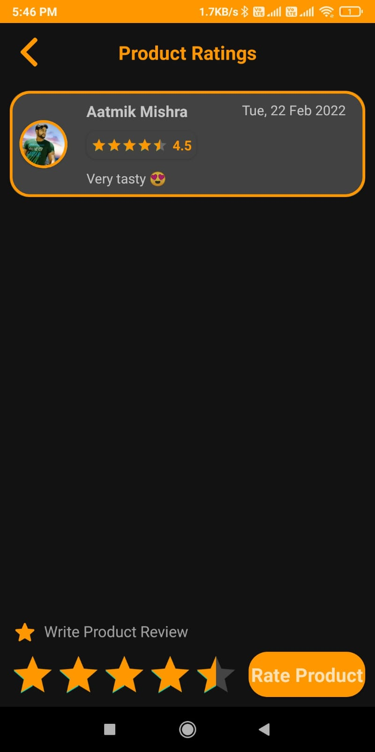
Application Snapshots
Cart and Ratings :

Slide 14
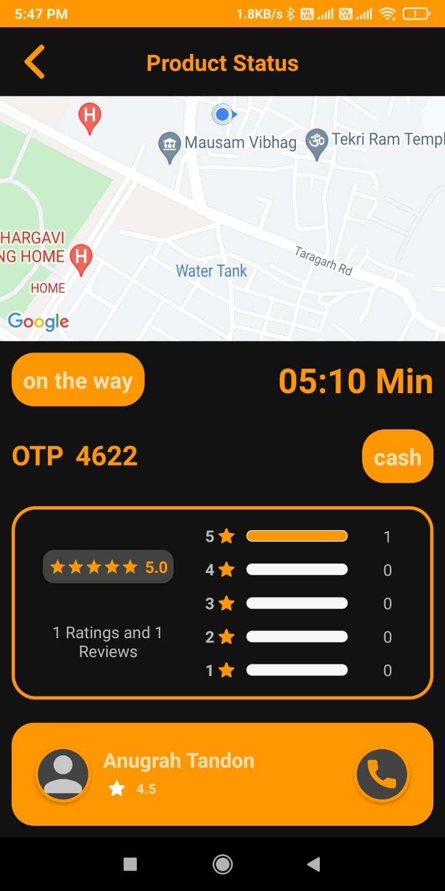
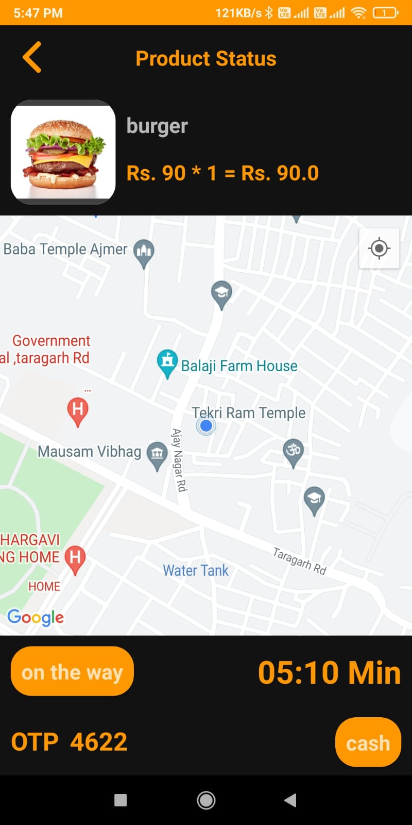
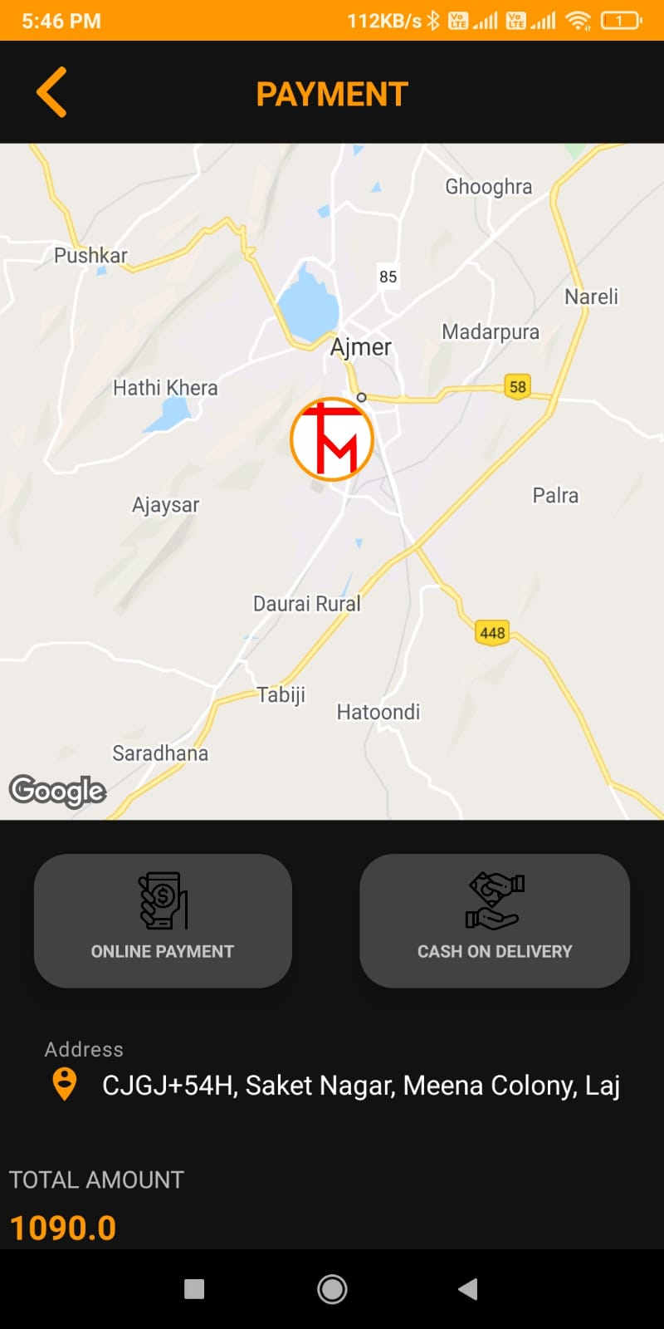
Application Snapshots
Product Status and Payment :

Slide 15
Marketing Strategy
The first step to advertise any product is to know your audiences. For us, our primary target audience is people living far from homes like non-local students or people living in other cities and working professionals. Therefore, these are our primary targeted audiences, as most of them struggle to get home-cooked food. Therefore, firstly we will start our marketing campaign from the colleges, which have non-local student campus. There we will meet the students and will explain our app with all the features and how this app will solve their struggle to get home-cooked meals staying away from home.
The other half of the project, which deals with delivering hot meals from the user's home to their designated location, we will follow the same formula to promote. Here we will visit the companies and will do the campaign their we will explain to work professionals how our app will deliver their home meal to their work locations, so they do not have to eat stale food anymore. This way, they could get their hot meal at their desired time.
For the initial period, the free delivery service would be offered when the user registers to the app. This way, a trust could be built by us for our users and would use our service in the future. This method is beneficial, as this would help promote our app more, among others, called word to-mouth marketing. As more the number of satisfied users, they would support our app amongst their friends and other social circle and this way, our word to mouth strategy will work.

Slide 16
Future Aspects
Improve UI and increase their standard.
Background Verification data of delivery boy on user screen.
Accept Indian rupees along with support for cryptocurrency.
OTP based verification.
Register your restaurant free and no monthly payment if no customers ordered from your restaurant like Zomato etc.

Slide 17
THANK YOU

